Slide 1
School of Computing Science and Engineering
Course Code : BTCS2401 Course Name: Computer Graphics
Specular reflection and Phong model
Name of the faculty: Suman Devi Program Name: B.Tech

Slide 2
School of Computing Science and Engineering
Course Code : BTCS2401 Course Name: Computer Graphics
Objective (Contents)
Specular Reflection
Specular Reflection Example
Effect of Specular Reflection
Phong Lighting
Phong Reflection Model
Computing Specular Reflection
Phong Model Illustration
Name of the faculty: Suman Devi Program Name: B.Tech

Slide 3
School of Computing Science and Engineering
Course Code : BTCS2401 Course Name: Computer Graphics
Specular Reflection
Specular reflection creates the appearance of “shininess.”
Surfaces with a high specular reflection appear very shiny.
Surfaces with a low specular reflection appear matte.
The intensity of specular reflected light varies with direction.
The maximum intensity is in the ideal direction.
Angle of reflection = angle of incidence
Name of the faculty: Suman Devi Program Name: B.Tech

Slide 4
School of Computing Science and Engineering
Course Code : BTCS2401 Course Name: Computer Graphics
Specular Reflection Example
Name of the faculty: Suman Devi Program Name: B.Tech

Slide 5
School of Computing Science and Engineering
Course Code : BTCS2401 Course Name: Computer Graphics
Effect of Specular Reflection
Specular Reflection exerts an effect on our perception of objects.
In Specular Reflection angle of reflection = angle of incidence
When a light ray meets an object, its beams do not go through the occurrence of specular reflection angle.
A number of beams being randomly reflected in multiple directions indicates diffuse reflection.
Name of the faculty: Suman Devi Program Name: B.Tech

Slide 6
School of Computing Science and Engineering
Course Code : BTCS2401 Course Name: Computer Graphics
Phong Lighting
The intensity of the reflection is a function of the angle between the viewer and the ideal direction r of reflection of light from the light source off the surface.
Name of the faculty: Suman Devi Program Name: B.Tech

Slide 7
School of Computing Science and Engineering
Course Code : BTCS2401 Course Name: Computer Graphics
Phong Lighting
Light
Source
Eye
Ideal
Direction
n
r
s
v
ϕ
ϕ
θ
P
Surface
Name of the faculty: Suman Devi Program Name: B.Tech

Slide 8
School of Computing Science and Engineering
Course Code : BTCS2401 Course Name: Computer Graphics
Phong Lighting
To compute r, note that r + s equals twice the projection of s onto n.
r
s
n
s
r
ϕ
ϕ
Name of the faculty: Suman Devi Program Name: B.Tech

Slide 9
School of Computing Science and Engineering
Course Code : BTCS2401 Course Name: Computer Graphics
Phong Lighting
The projection of s onto n is
(s ⋅ n)/(n ⋅ n)n = (s ⋅ n)n
Therefore,
r + s = 2(s ⋅ n)n
and
r = –s + 2(s ⋅ n)n
Name of the faculty: Suman Devi Program Name: B.Tech

Slide 10
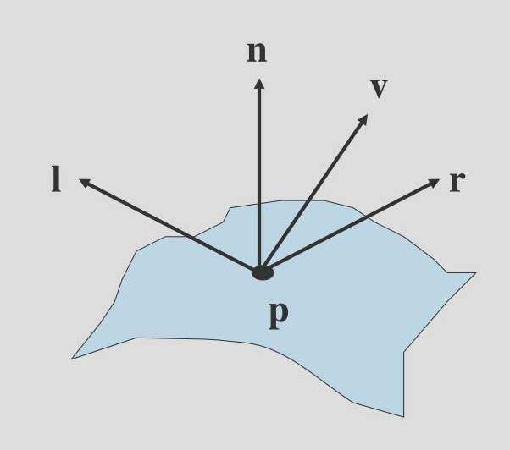
School of Computing Science and Engineering
Course Code : BTCS2401 Course Name: Computer Graphics
Phong Reflection Model
Name of the faculty: Suman Devi Program Name: B.Tech

Slide 11
School of Computing Science and Engineering
Course Code : BTCS2401 Course Name: Computer Graphics
Phong Reflection Model
Shiny surfaces have a narrow specular reflection range, and dull surfaces have a wider reflection range. An empirical model for calculating the specular-reflection range, developed by Phong Bui Tuong and called the Phong specular-reflection model.
Name of the faculty: Suman Devi Program Name: B.Tech

Slide 12
School of Computing Science and Engineering
Course Code : BTCS2401 Course Name: Computer Graphics
Phong Reflection Model
Intensity of specular reflection proportional to cos^{ns}Ø.
Angle Ø can be assigned values in the range of 0 to 90, so that cos Ø varies from 0 to 1.
The value assigned to specular-reflection parameter n_{s} by the type of surface.
For rough or dull surfaces n_{s} is close to 1 and for shiny surfaces it would be a large value (say, 100 or even more).
Name of the faculty: Suman Devi Program Name: B.Tech

Slide 13
School of Computing Science and Engineering
Course Code : BTCS2401 Course Name: Computer Graphics
Phong Reflection Model
Supports three types of light-surface interactions:
Ambient
Diffuse
Specular
Name of the faculty: Suman Devi Program Name: B.Tech

Slide 14
School of Computing Science and Engineering
Course Code : BTCS2401 Course Name: Computer Graphics
Phong Reflection Model
Each source has an ambient, a diffuse and a specular component for each of the three primary colors
Li =
Lira | Liga | Liba
Lird | Ligd | Libd
Lirs | Ligs | Libs
Name of the faculty: Suman Devi Program Name: B.Tech

Slide 15
School of Computing Science and Engineering
Course Code : BTCS2401 Course Name: Computer Graphics
Phong Reflection Model
The amount of light reflected at each surface point has an ambient, a diffuse and a specular component for each of the three primary colours
Lira | Liga | Liba
Lird | Ligd | Libd
Lirs | Ligs | Libs
Ri =
Name of the faculty: Suman Devi Program Name: B.Tech

Slide 16
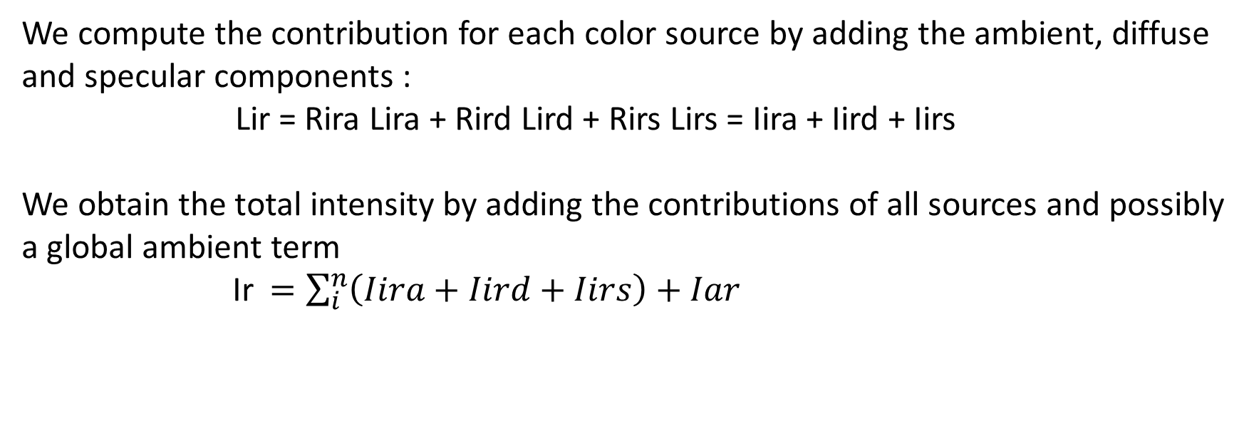
School of Computing Science and Engineering
Course Code : BTCS2401 Course Name: Computer Graphics
Phong Reflection Model
We compute the contribution for each color source by adding the ambient, diffuse and specular components : Lir = Rira Lira + RirdLird + RirsLirs = Iira + Iird + Iirs
We obtain the total intensity by adding the contributions of all sources and possibly a global ambient term
Ir$=\sum_{i}^{n}{\left(Iira+Iird+Iirs\right)}+Iar$
Name of the faculty: Suman Devi Program Name: B.Tech

Slide 17
School of Computing Science and Engineering
Course Code : BTCS2401 Course Name: Computer Graphics
Computing Specular Reflection
According to the Phong lighting model, the specular reflection is proportional to the cosine of the angle between v and r, raised to a power (called “shiny”).
This is calculated as
(r ⋅ v)^{shiny}
Name of the faculty: Suman Devi Program Name: B.Tech

Slide 18
School of Computing Science and Engineering
Course Code : BTCS2401 Course Name: Computer Graphics
Computing Specular Reflection
Two other factors are
Intensity of the incident light.
0 ≤ L_{s} ≤ 1.
Specular property of the surface.
0 ≤ m_{s} ≤ 1.
The formula for specular reflection is r_{s} = L_{s}m_{s}(r ⋅ v)^{shiny}
Name of the faculty: Suman Devi Program Name: B.Tech

Slide 19
School of Computing Science and Engineering
Course Code : BTCS2401 Course Name: Computer Graphics
Computing Specular Reflection
Of course, if s ⋅ n < 0 or if r ⋅ v < 0, then r_{s} = 0.
Name of the faculty: Suman Devi Program Name: B.Tech

Slide 20

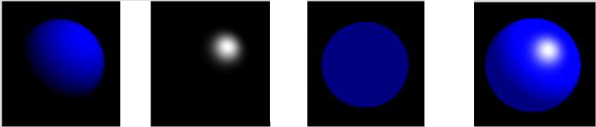
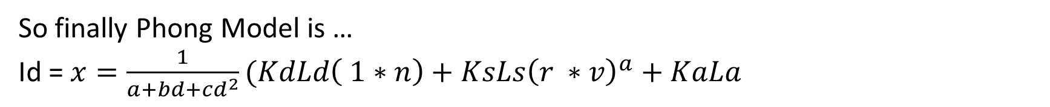
School of Computing Science and Engineering
Course Code : BTCS2401 Course Name: Computer Graphics
Phong Model Illustration
So finally Phong Model is …
Id = $x=\frac{1}{a+bd+{cd}^{2}}(KdLd\left( 1∗n\right)+KsLs{\left(r ∗v\right)}^{a}+KaLa$
Name of the faculty: Suman Devi Program Name: B.Tech

Slide 21
School of Computing Science and Engineering
Course Code : BTCS2401 Course Name: Computer Graphics
Summary
Specular reflection depends on the type of surface used. To manage veiling reflections appropriately, install luminaires in a strategic fashion. Go through a trial-and-error process before finding the perfect location.
The Phong model is not really based on anything real. It does not deal in microfacet distributions at all. What the Phong model is is something that looks decent enough and is cheap to compute. It approximates a statistical distribution of microfacets, but it is not really based on anything real.
Name of the faculty: Suman Devi Program Name: B.Tech

Slide 22
School of Computing Science and Engineering
Course Code : BTCS2401 Course Name: Computer Graphics
Reference :
1 . Donald Hearn and M Pauline Baker, “Computer Graphics C Version”, Pearson Education, India; 2 edition 2002.
2. Computer Graphics Principles and Practice, Second Edition in C, James D.Foley, Andries Van Dam, Steven K.Feiner, JhonF.Hughes, Addison Wesley, Third Edition, 2014.
3. Steven Harrington, “Computer Graphics: A Programming Approach” , McGraw-Hill Inc.,US; 2nd Revised edition, 1983.
4. David Rogers, “Procedural Elements of Computer Graphics”, McGraw Hill Education; 2 edition, 2017.
Name of the Faculty: Suman Devi Program Name: B.Tech

Slide 23
School of Computing Science and Engineering
Course Code : BTCS2401 Course Name: Computer Graphics
Thank you!
Name of the Faculty: Suman Devi Program Name: B.Tech

